Slide 1
Scrumming Towards Sustainable Development Goals – An Experimental Workshop
Sabine Canditt, sabine.canditt@improuv.com
Paul Marshall paul.marshall@improuv.com

Slide 2
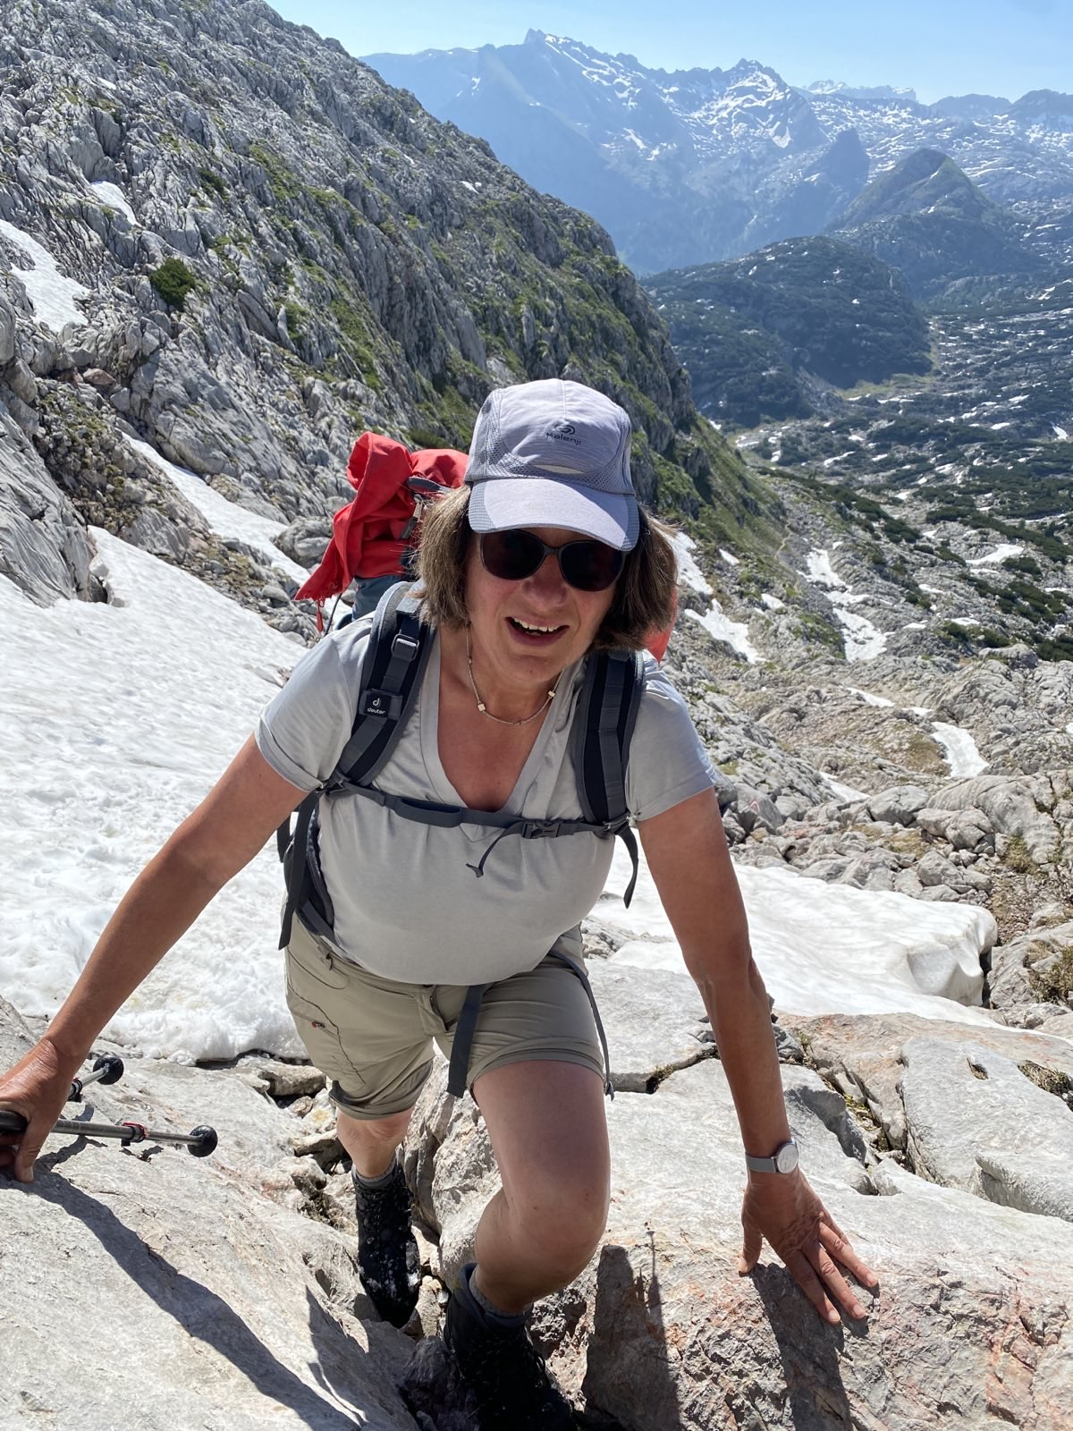
Das sind wir
Sabine, CST, CEC, CTC, ICF PCC
Mother of two sons, nature lover
Author, Consultant for Global Change
Co-founder of improuv-planet.com
Board member Sustain-Agility Verein
Paul, Agile Coach ,CSP, Trained Coach & Facilitator, Aspiring Scrum Trainer
Mountains, Physicist, Father: We experiment with sustainability at home
Greatest hope: Small steps to culture change

Slide 3
Agenda
Goal: Validate hypothesis that agile community can contribute to sustainability
Introduction
 | Who we are, why this workshop | Trainers
 | What are Sustainable Development Goals (SDGs)? | Trainers
Sprint 1
 | Develop „product idea“ for one SDG | Interactive
 | Analyze sustainability and stakeholders | Interactive
Sprint 2
 | Hypotheses and validations | Interactive
 | First week activiy | Interactive
Debrief
Notes:
Sabine
90 sehr sehr knapp

Slide 4
17 Sustainable Development Goals: People, Planet, Prosperity
“A shared blueprint for peace and prosperity for people and the planet, now and into the future.”
Formulated in 2015 by the United Nations General Assembly
Core of the Agenda 2030
https://www.un.org/sustainabledevelopment/news/communications-material/
Notes:
Sabine
4:00 min check Forestry: Don't cut more trees than can grow back.
Sustainability is a global topic. This has been recognized by the UN with the 17 Sustainable Development Goals … s. Folie. These goals were set in 2015, and we're halfway there now. A recent report from the United Nations said that only 15% of the goals are on track. We need to do more. Every little thing we do matters.
What's special about the SDGs is that they are all connected. They are meant to achieve a balance between People, Planet and Profit. The economic system is driven by profit, but it needs people, air, water… the planet. Seen from a economic perspective, the long term costs caused by climate change are higher than the costs for mitigating the climate change ( Goal 1). So lets look at this for an example to understand how these goals are connected.
We cannot prevent climate change any more, but at least to at least to mitigate it, we need to reduce our greenhouse gas emissions. Where do these come from? The world's wealthiest 10% of people are responsible for around half of global emissions. The United States are responsible for 25% of historical emission, the 28 countries of the EU 22%. Prosperity is related to CO2 emissions. We, the people of the rich countries, want to maintain or even improve our lifestyle. We can't ask poor countries to stay poor so we can stay rich. Of course they strive for Decent Work and Economic growth (Goal 9). The dramatical difference on a global scale are also visible in countries like Germany. People with little money rather live in insufficiently insulated apartments in densely built-up neighborhoods. And they are very often in poorer health than those who are better off. We have to understand climate action as a task that requires social justice and cohesion, fighting poverty (Goal 1) and hunger (Goal 2)
The SDGs are a call to action for every country, not just governments and companies but also regular people like us. As agilists, we can make meaningful contributions. We are change facilitators and work with corporations that have an impact. We understand that small actions, that are aligned can make big changes.
We will show you 2 examples how this can be done. We then want to give you the chance to look at some of the SDGs in more detail and develop your own idea of a product or service that could solve a SDG related problem. Of course we don’t expect to rescue the world in 90 minutes. We call this an experiential workshop because we want to give it a try. Thank you for participating in this experiment, we count on you.

Slide 5
Sprint Backlog
Sprint 1
Story 1
Idea for one SDG
(product or service)
Story 2
Stakeholders and their goals
Notes:
Paul 60 sek

Slide 6
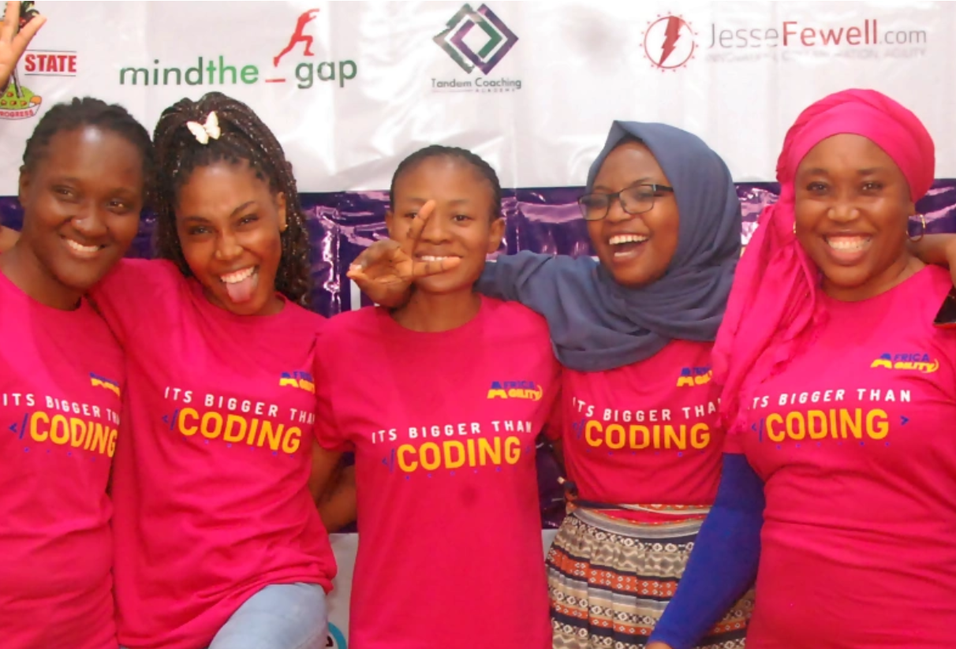
Example 1 - SDGs and Agility: Africa Agility
A five-month program designed to provide young African women with tech and Agile training, mentorship, career and job opportunities.
Founder: Aanu Gopald, CST
Since 2020, 15.000 trained in 22 countries
Goals: By 2030, 500,000 girls will have received training, 60% will be employed.
https://africaagility.org/
Notes:
Sabine 3 min check
One of the big global questions is: will the planet be able to feed the people living on it? At the moment, there are around 8 billion people on earth. 2050 we will be around 10 billions. Probably the population will stop to increase after 2050, and even decrease. At the moment, around one in six people on earth is African. Unlike in the rest of the world, the population in Africa will continue to grow. Around half of the 2 billion additional people between now and 2050 will be born in Africa. Nigeria will increase the USA in population.
There is data to support the following: The vast majority of the billions of people who were able to leave extreme poverty behind in the last decades chose to have fewer children. To limit population growth, what would make more sense than to help girls and women in Africa get into jobs that will help them. This is closely related to Gender Equality. African women are less likely to be employed, earn lower wages, are less likely to be able to influence government policy, and experience high levels of violence. Education and job opportunities for African women play a crucial role in changing this situation and thus slowing down population growth. This is what initiated the idea of Africa Agility.
It was started by Aanu Gopald, CST, with big goals. Cite slide. This example shows again how the SDGs are interrelated. Starting with 'No Poverty,' she thought about what she, as a Scrum trainer, could do: 'Quality Education.' Since she wanted to teach many girls, she couldn't do it alone. She reached out to a group of female CSTs for support and got it (Partnership to the Goals). The investment was limited. Each of us took a 3-hour slot in a training. I had the topic 'Definition of Done.' I prepared, but it wasn't particularly difficult for me because I often talk about it. Each of us was happy to help, as we understood the great impact of this initiative: Tech jobs for women will not only support the women themselves, but also their families, local communities and society as a whole (Decent Work and Economic Growth).

Slide 7
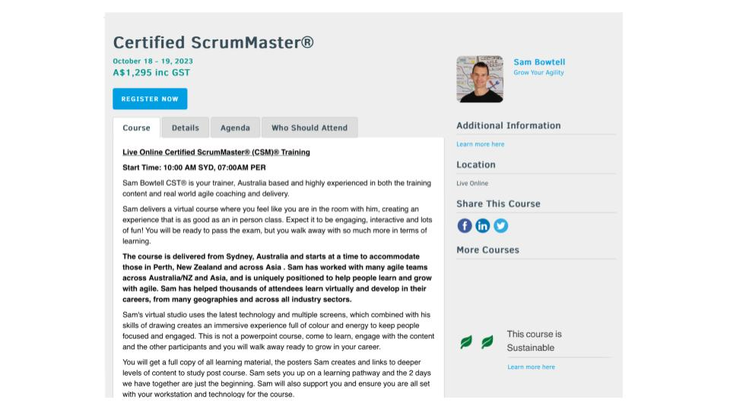
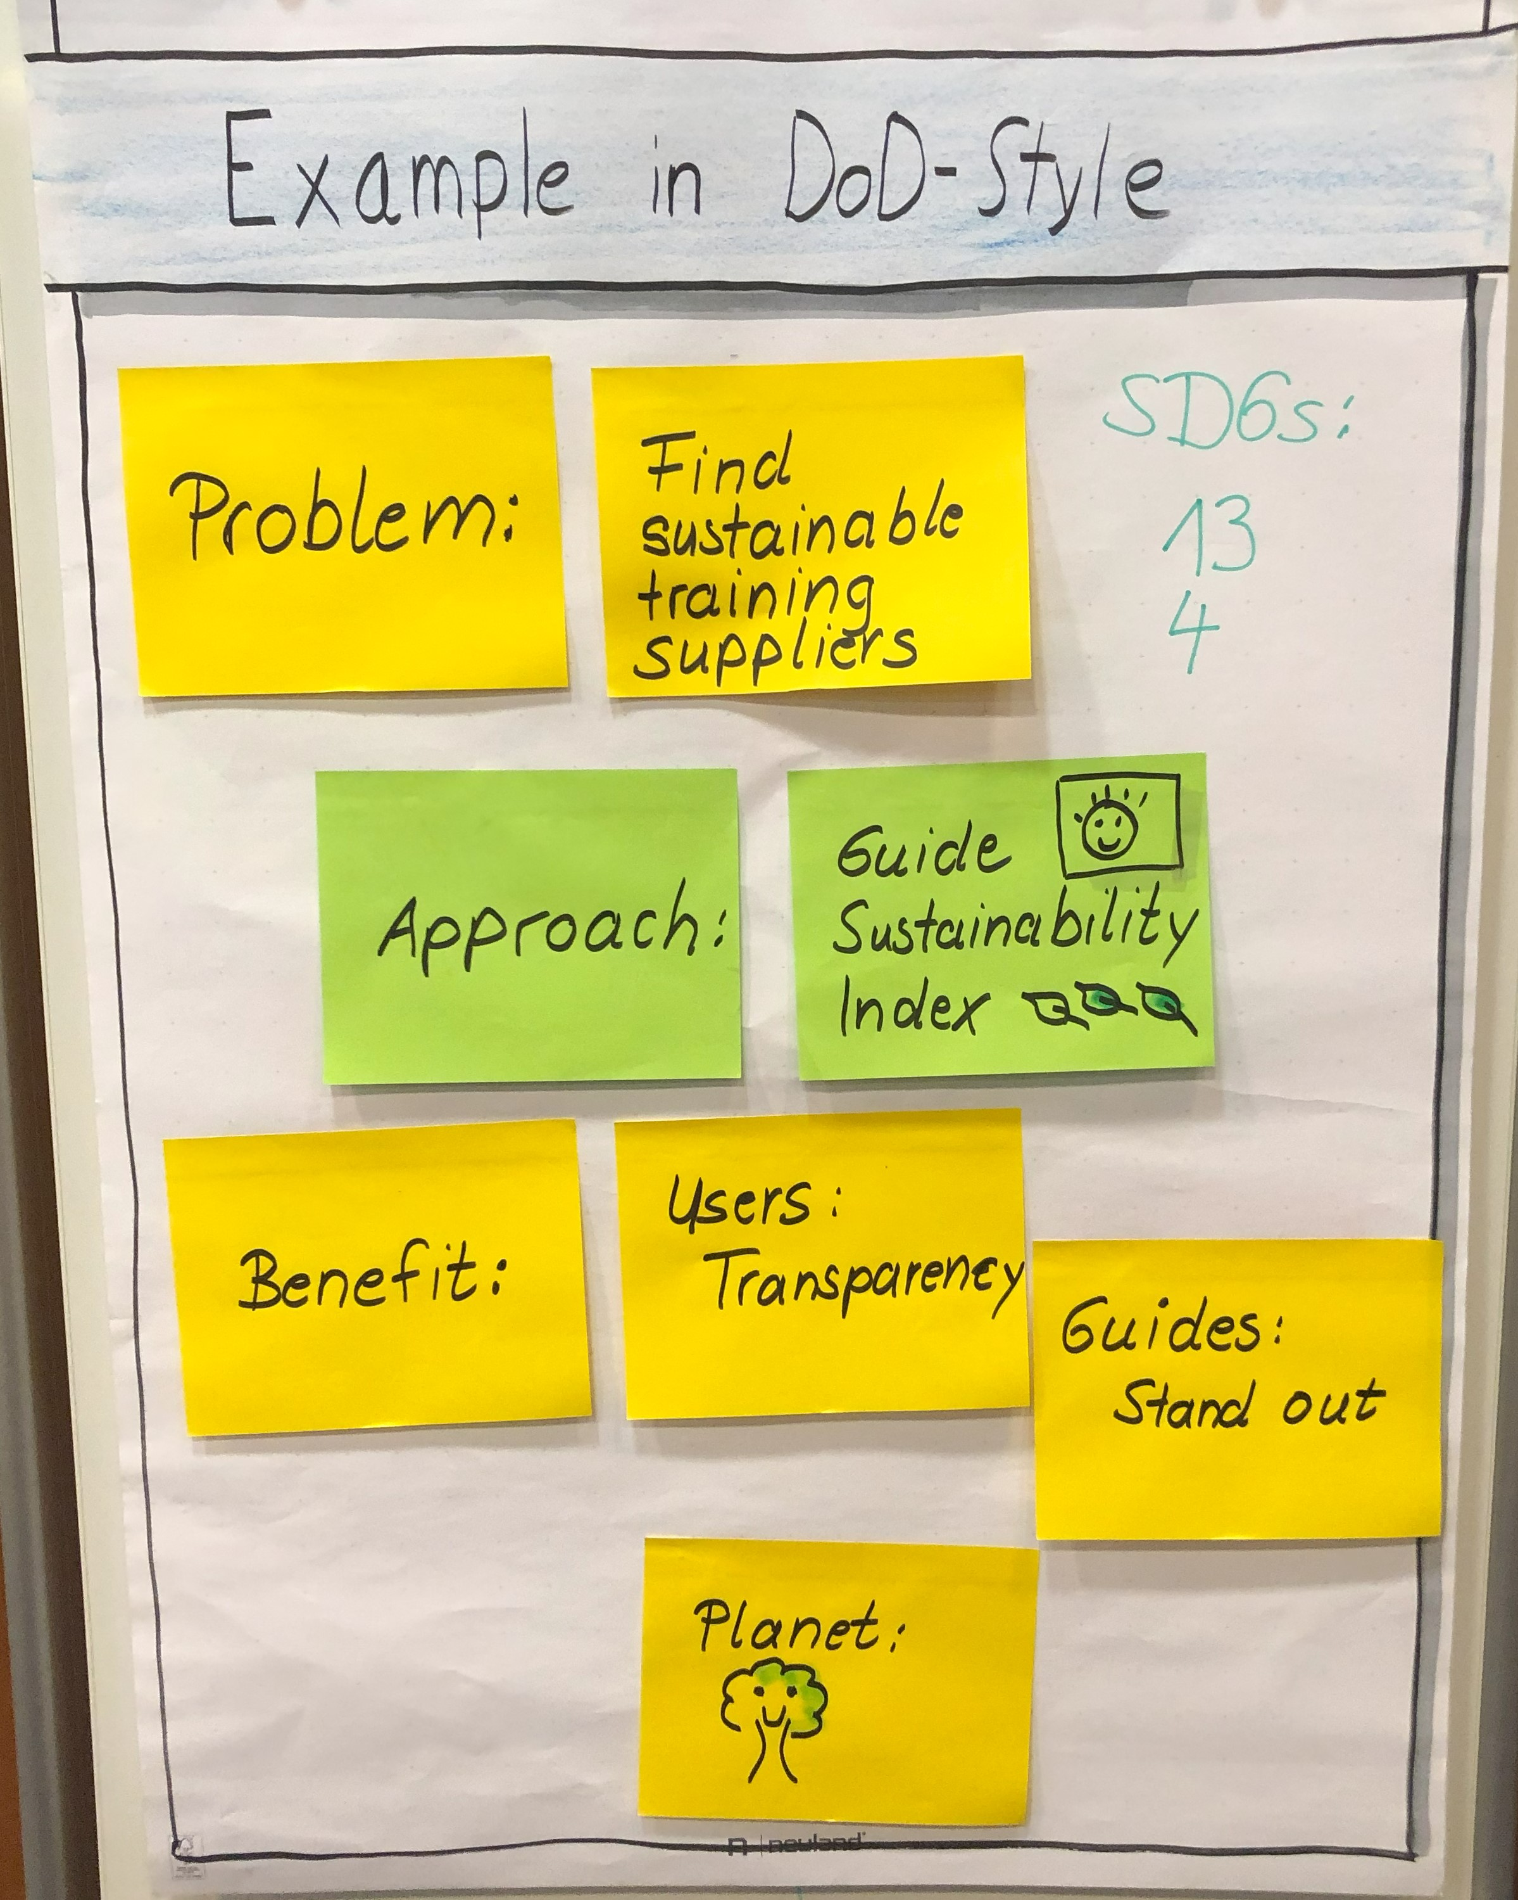
Example 3 – SDGs and Agility: Guides Sustainability Index
Notes:
1 min

Slide 8
YES, AND.. - Attitude
Ideas Changable on Sticky Notes
People can understand just by looking at it
Definition of Done
Use colors, have fun..
Notes:
Paul 3 min

Slide 9
Teamwork at Table
Story 1
Idea for one SDG
Story/Task:
Starting from one SDG: Develop idea for a product or service in context related to group.
If there is time, see if other SDGs also benefit
Acceptance Criteria:
At least one person in group should be capable to act on the idea
Includes SDG(s)
Includes product name, approach, benefit
10 minutes
Notes:
Paul 60 sek
Team 12 min

Slide 10
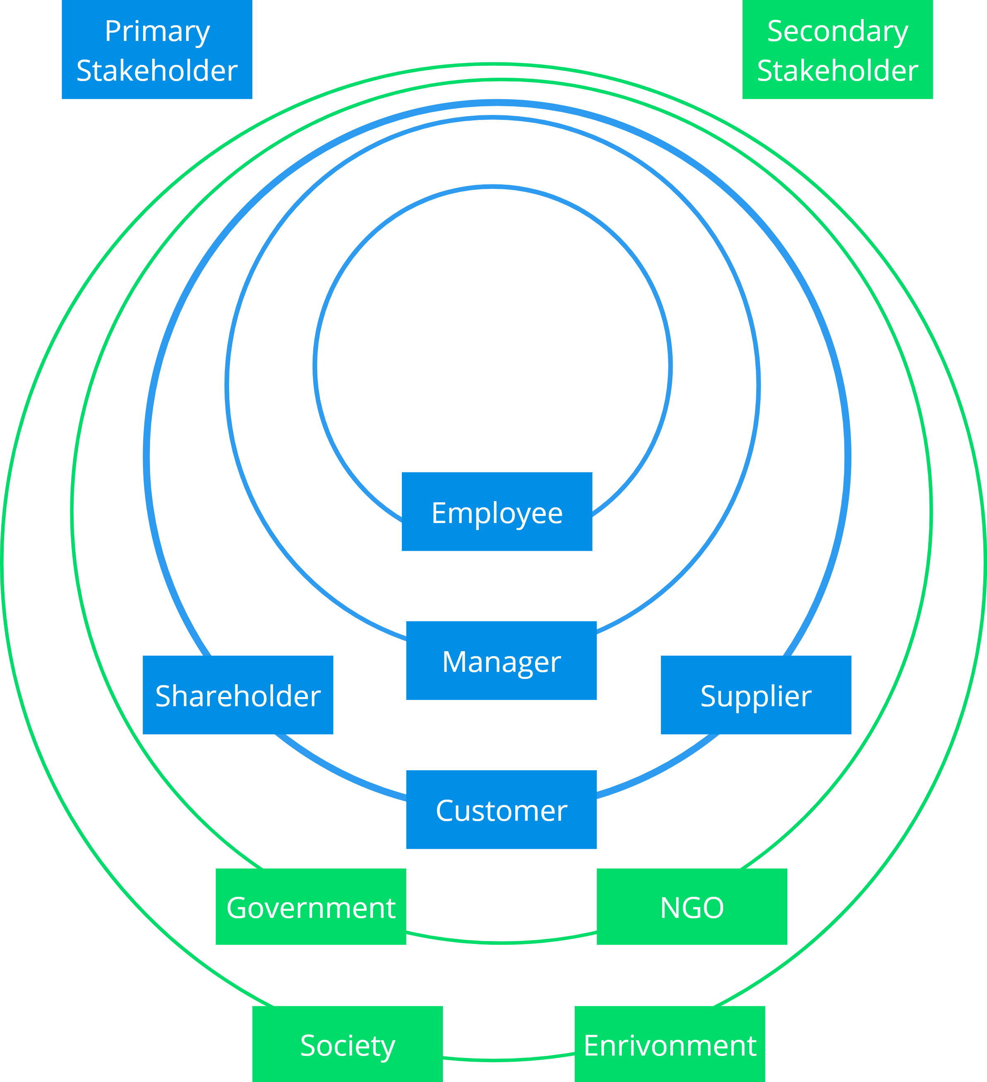
Sustainability and Stakeholders
“Any group or individual who can affect or is affected by the achievement of the firm’s objectives”. (Richard Freeman)
No distinction between primary and secondary stakeholders.
No financial objectives at the expense of social and environmental objectives.
https://www.imd.org/research-knowledge/sustainability/articles/engaging-sustainability-stakeholders/
Notes:
Sabine 3 min check
Which stakeholders do you consider in your product development or initiative? It is very common to consider business people in the organisation, even less common to consider customers and users. We call these primary stakeholders because they are directly tied to an organization through financial transactions. One crucial change when becoming more sustainable engage with a variety stakeholders to understand and respond to their needs.
Secondary stakeholders, on the other hand, include those who are indirectly impacted by an organization or who indirectly impact an organization. Secondary stakeholders have the same stake in an organization, as do primary stakeholders. Cite slide.
The 2 way communication with stakeholders plays an important role in the journey to sustainability and is required as a basis for regulatory reporting.

Slide 11
Africa Agility: What are possible stakeholders?
Stakeholder |  | Goal
Students | Primary | Find a job with a decent income
Trainers (volunteers) | Primary | Sense of fulfillment, visibility
Families | Secondary | Financial support
Notes:
Sabine 3 min
Weitere Stakeholder: Employers, Scrum Alliance

Slide 12
Teamwork at your Table
Story 2
Stakeholders and Goals
Story/Task:
Collect Stakeholders for your product or service
For each stakeholder (or some): Identify a relevant goal for your idea
Acceptance Criteria:
Min one primary stakeholer and their goal
Min one secondary stakeholder and their goal
8 minutes
Notes:
60 sek paul
10 min team

Slide 13
REVIEW
SHARE BETWEEN TEAMS
1-2 minutes
RETROSPECTIVE AT YOUR TABLE
YES AND?
INCREASE FUN/JOY?
3 minutes
Notes:
60 sek
6 min

Slide 14
Sprint Backlog
Sprint 2
Story 3
Critical Hypotheses
Story 4 First Week Action
Notes:
1 min

Slide 15
Africa Agility: What are critical hypotheses, and how to validate them?
Hypotheses | Validation
There is sufficient demand for a training. | # student applications
There are enough trainers who are willing to participate | # trainers recruited
https://www.youtube.com/watch?v=1n2v8trtq3w&t=128s
Notes:
3 min

Slide 16
Teamwork at your Table
Story 3 Critical Hypotheses
Story/Task:
Brainstrorm underlying hypotheses that are critical for success
For each (or some): Come up with a simple and fast way to observe and learn (validation)
Acceptance Criteria:
Min 2 pairs of hypothesis and validation
Validation can be done in <2 months
8 minutes
Notes:
1 min
10 min

Slide 17
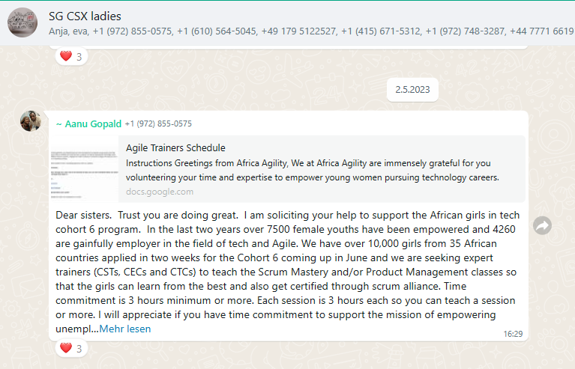
Africa Agility: What could be activities to start with?
Hypothesis:There are enough trainers who are willing to participate
Create presentation of concept
Publish in trainer group
Contact trainers personally
Notes:
3 min

Slide 18
Teamwork at your Table
Story 4 First Week Action
Story/Task
Come up with a „first week action“ for your initiative
Acceptance Criteria
Can be done by two people in a week
5 minutes
Notes:
1 min
5 min

Slide 19
REVIEW
TAKE A PHOTO :-)
RETROSPECTIVE ROUND AT TABLE
DISCUSS AFTER THIS EXPERIENCE:
HOW MUCH CAN THE AGILE COMMUNITY CONTRIBUTE TO SDGs?
Notes:
1
6

Slide 20
Inspect. Adapt. Sustain. www.improuv-planet.com

